Slide 1
CS 4530: Fundamentals of Software Engineering
Module 7.1: Software Development Processes
Adeel Bhutta and Mitch Wand
Khoury College of Computer Sciences
© 2026 Released under the CC BY-SA license

Slide 2
So, software engineering must encompass:
PEOPLE
PROCESSES
PROGRAMS
We are here today!
PLANNING
ORGANIZING
implementing
Notes:
So far in this class, every lecture has been about 3 Ps in some way (organizing people, understanding processes, and writing programs): when we talk about testing or typescript, we saw a lot of code but discussed how contracts and tests are communicating with the future (people) and how code coverage metrics lets us quantitively assess our progress (processes).
Today we focus a little more on “processes”, then “people”

Slide 3
Learning Goals for this Lesson
At the end of this lesson, you should be able to
  Know the basic characteristics of the waterfall software process model
  Be able to explain when the waterfall model is appropriate and when it is not
  Understand how the waterfall and agile models manage risk
  Be able to explain how agile process instill quality, including through test driven development
Notes:
<read slide>

Slide 4
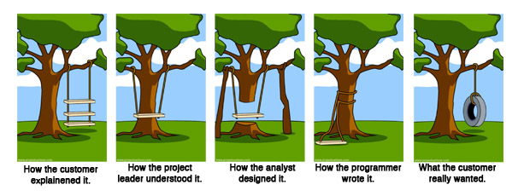
Review:
How to make sure we are building the right thing
Requirements Analysis
Planning & Design
Implementation
Notes:
In a previous modules we talked about how requirements analysis is a tough problem, and how gaps in understanding between our team and our client can be problematic. While getting the right requirements can certainly help make sure we build the right thing, it definitely doesn’t guarantee it. This comic also points out the gaps in the actually process of building the software – between the project leader, the designer, and the implementer. How we orchestrate this process and determine the overall scope of a project is a hard problem.

Slide 5
Software Process: Code + Fix
Build First
Version
Modify until
Customer satisfied
Operations
Retirement
Notes:
This is the baseline approach, which we’ll call “Code and fix”. (Describe the boxes; make the joke that “retirement” might refer to the software, or more likely, the programmer, thanks Mitch ☺ )
What is good about this?
No planning
No expertise
No overhead
Good for “hacking” single use/personal use programs
What is bad about this?
No planning
No way to assess progress ← this is probably the biggest point to make
Difficult to coordinate multiple programmers
What do you think would happen if this was the only way that we built software?
Would the resulting software be:
Delivered on time?
Fully featured?
Performant?
Maintainable?

Slide 6
Waterfall Process Improves on Code + Fix (~1970s)
systematic, sequential approach
Requirements
Quality Assurance at each phase before continuing
Validate
Design
Verify
Implementation
Test
Measurable progress with risk contained in each phase
Quality Assurance at each step
Possible to estimate each phase based on past projects
Division of labor: Natural segmentation between phases
Operations
Retirement
Notes:
Discuss how waterfall improves over code + fix
Organization
Formal QA process - can conduct QA at each level
Division of labor: senior architects do planning and modeling, junior do construction + QA
Division of labor: might even have some external consultants/auditors who work through your requirements, too
Discussion point: is this division of labor good?
Do we all agree that the senior devs should be doing design, junior the QA?

Slide 7
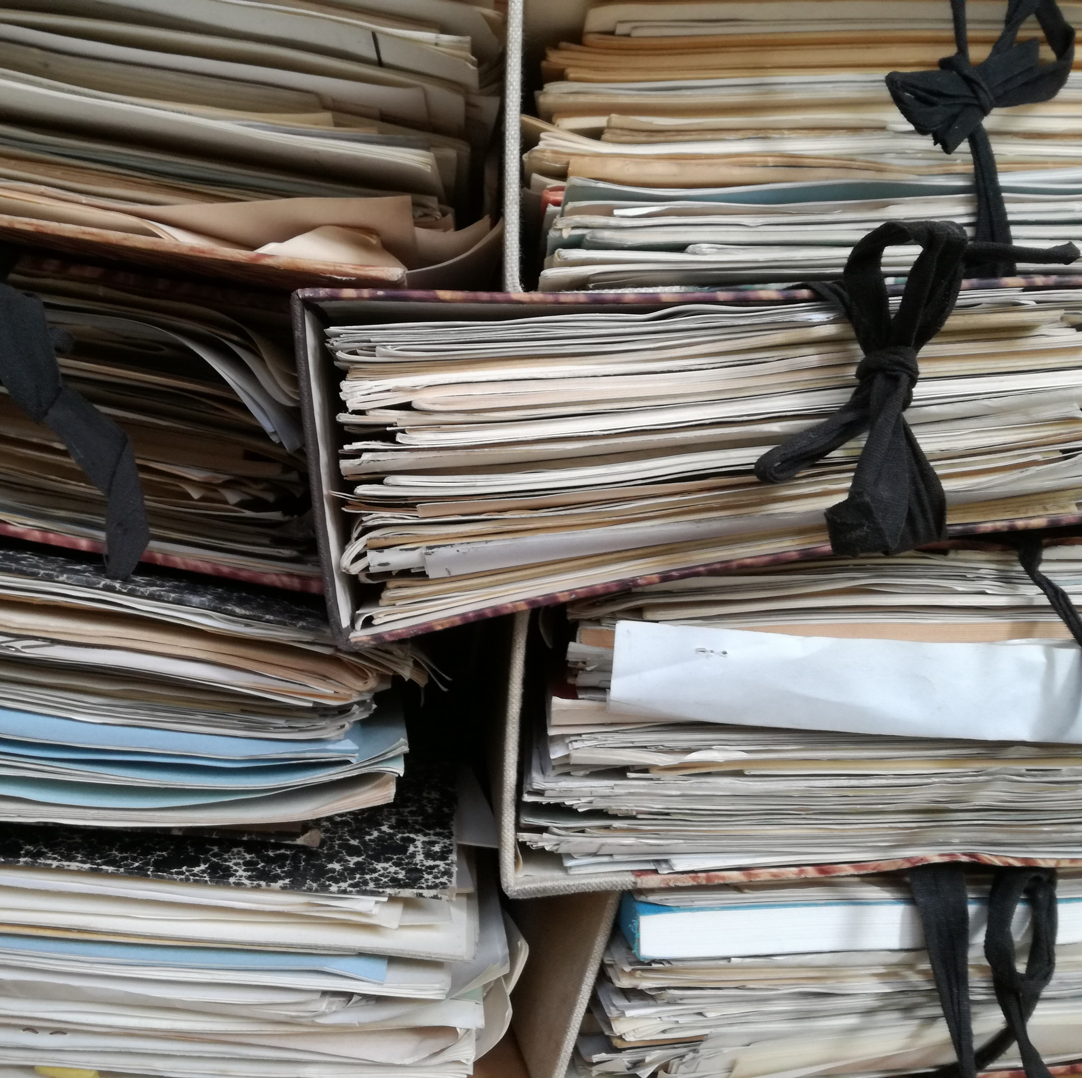
Waterfall Model adds process overhead and produces Wasted Work Product
Since formal quality assurance happens at each phase, it’s necessary to produce extremely detailed documentation (requirements, design, testing)
But
Documentation produced per requirements was never read, Elaborate architectural designs never used
Notes:
Emphasize that each phase produces some artifact:
Requirements documents
Design documents
Source code
Waterfall requires *extremely* thorough planning, because you will not proceed to the next step until you are certain that those artifacts are correct. There is no room for interpretation or variance.

Slide 8
Waterfall Model: Applications
What projects would this work well in?
  Projects with tremendous uncertainty or risk
  Projects with long time-to-market
  Projects that need extensive QA of requirements and design
  Projects for which the expense of the planning is worth it
  Classic examples: military/defense
    Warship that needs to have component interfaces last 80 years
    Spacecraft?
Notes:
What if I am the US government, building a naval warship that costs so much money that we expect that it will last at least 80 years?
What will the ship need to do? What will it interface with?
Tremendous uncertainty, but our goal is to draw plans in advance so that we can adapt later when needed
Note: we don’t need every ship in the component to last for 80 years: we are sure to design something with extension points, and upgradable components. But the INTERFACE for those components probably can’t change.
Very much benefits from the “expensive planning up front with external QA teams to review those plans” kind of process
This is not most of our software, though
Overall philosophy: "The project is too large and complex, and it will take months (or years!) to plan, so once we come up with the plan, that plan can not change"
assumption: cost to make a change or fix a defect grows exponentially over time - the usual kind of big curve that everyone wants to shift left on.
Nerdy bit: This process draws on classic industrial engineering principles developed by Frederick Taylor; one of the key pieces that everyone needs to understand is that you have a separate QA team that performs QA at each phase of the process

Slide 9
Waterfall Model: Risk Assumptions
The cost to fix a defect grows exponentially with each development phase
Waterfall Model Reduces Risk by Preventing Change
  No way to go “back up”
Notes:
Overall philosophy: "The project is too large and complex, and it will take months (or years!) to plan, so once we come up with the plan, that plan can not change"
assumption: cost to make a change or fix a defect grows exponentially over time - the usual kind of big curve that everyone wants to shift left on.
Nerdy bit: This process draws on classic industrial engineering principles developed by Frederick Taylor; one of the key pieces that everyone needs to understand is that you have a separate QA team that performs QA at each phase of the process
This big focus on QA of each phase means that even if you wanted to go back to a prior phase (and there are “iterative” versions of the waterfall process, too), you are going to need to throw out a lot of work! What was the point of the extremely thorough requirements documents when you are going to throw them out?
Therefore, this model is only appropriate when the requirements are very well-understood and changes will be very limited during the design process. But few business systems have stable requirements.

Slide 10
Iterative Process (~1980s) are Waterfall Variations
Initial Concept
Requirements
and Iteration
Planning
Next Iteration
Design and
Implement
Acceptance
Testing
and Delivery
Operations
Notes:
The iterative process takes a waterfall, and it basically just says: “Hey, split up your huge project into smaller projects, deliver each of those projects in one iteration of a waterfall”
Core idea: System requirements ALWAYS evolve in the course of a project so process iteration where earlier stages are reworked is always part of the process for large systems.
User requirements are prioritized and the highest priority requirements are included in early iterations.
Once the development of an iteration is started, the requirements are frozen - but requirements for later iterations can continue to evolve (this is the distinction compared to incremental delivery of feature sets)
There are a variety of pr

Slide 11
Agile Manifesto (~2000)
We are uncovering better ways of developing
software by doing it and helping others do it.
Through this work we have come to value:
That is, while there is value in the items on
the right, we value the items on the left more.
Individuals and interactions
Working software
Customer collaboration
Responding to change
over processes and tools
over comprehensive documentation
over contract negotiation
over following a plan
https://agilemanifesto.org
Notes:
The agile manifesto outlines the key principles that underpin agile processes. There are a variety of interpretations of this idea, “software craftsmanship” and “extreme programming” are some.
These values are a direct response to the waterfall processes.
Individuals and interactions – talk about things, localize knowledge vs these big modeling-based approaches. Typically embrace pair programming
Working software – write code that works and is readable, come up with techniques to make it be more likely to be correct.
Respond to change – manage uncertainty by designing and implementing what you need today, don’t make detailed plans in the future
Please note that agile is often talked about as a set of principles and processes that must be obeyed to the letter of the law. We do not claim what is the One True Way™, and many companies will offer certifications in agile this or agile that. Our focus for the next two lessons will be on understanding how agile principles manage risk and improve quality in software development.
If you would like to share this context, it is interesting to point out that the “Agile manifesto” was written and co-signed by 17 white men at a ski resort in Utah. This talk has a nice discussion of this - https://www.youtube.com/watch?v=YL-6RCTywbc

Slide 12
Warning: Agile can be a buzzword
Notes:
A lot of different variants of “Agile”
Scrum, Kanban, XP are just a few

Slide 13
The Agile Model Reduces Risk by Embracing Change
The Waterfall philosophy:
  "The project is too large and complex, and it will take months (or years!) to plan, so once we come up with the plan, that plan can not change"
  Reduce risk by proceeding in stages
The Agile philosophy:
  The project is too large and complex, it is unlikely that we will know exactly what we need right now, and to some extent, we are inventing something new. We think that as we make it, we will figure it out as we go”
  Reduce risk by limiting time on any one stage; then reassess. (“time-boxing”)
Notes:
Throughout the 90’s there were a variety of different software process models proposed to be “more lightweight” than waterfall. We won’t discuss them, other than to say that there were quite a few, and that agile came out on top.
Agile offers the following promise: what if we could build software in such a way that we could embrace both defects and change. If you build a process that can have an “agile” response to shifting requirements, you are also probably building one that can tolerate defects much better.
Compare to waterfall philosophy on risk:
Waterfall says: "The project is too large and complex, and it will take months (or years!) to plan, so once we come up with the plan, that plan can not change"
agile says “The project is too large and complex, it is unlikely that we will know exactly what we need right now, and to some extent, we are inventing something new. We think that as we make it, we will figure it out as we go”

Slide 14
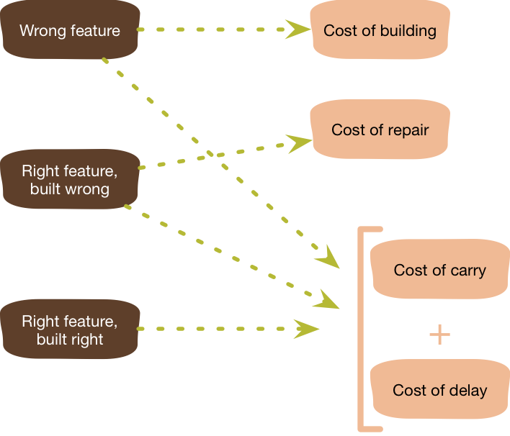
Agile Practice: YAGNI
YAGNI – “You Aren’t Going To Need It”
Do not prematurely plan or implement features
Why? Uncertainty in what we actually need
Focus on prioritization, independent of estimation
Graphic: Martin Fowler
Notes:
With this lesson from meteorology in mind, let’s start to talk about the principles of agile planning. Recall that one of the goals of agile processes is to embrace uncertainty. The first principle is articulated by Martin Fowler in the acronym “YAGNI” (pronounced yag-knee).
If we go into a software project with the first principle “embrace change”, then we need to be willing to tolerate changes to our requirements that come from our users. We also need to embrace changes to our process and plans that come from our evolving understanding of what it is that we need to build, and how it should be built.
The YAGNI philosophy argues that pre-maturely planning and implementing features will almost inevitably result in wasted effort and a delayed schedule. Why? Because with a lot of software projects, both we and our customers may not know exactly what it is that is needed until we get closer to needing it. Consider the hurricane map: 5 days out, can we know what degree of preparations should be in Ohio or Indiana, which seem like they might be outside of the track of the storm, but could also be totally outside of the track of the storm?
One risk is that we end up building the totally wrong feature, in which case we wasted time planning and building that feature, plus the cost to continue to maintain and carry this feature that we now implemented, and the cost to delay other more important features. Building the feature in the wrong way also adds the cost to do it right, and even in the best case (where we built the feature correctly), we have still delayed other more important things from getting built

Slide 15
Agile improves on other approaches
Compare to problems in waterfall:
Requirements that become obsolete
  Don’t make detailed requirements until you need them
Elaborate architectural designs never used
  Don’t design until you need
Code that sits around not integrated and tested in production environment, eventually discarded
  Integrate and test continuously
Documentation produced per requirements, but never read
  Don’t require documentation
Or only as much documentation as you really need.
Notes:
Returning to the agile values, we can see how they can respond to problems in the waterfall methodology and ultimately reduce the cost of uncertainty.

Slide 16
Agile Practice: Everyone is Responsible for Quality
“Collective ownership”
Requirements (user stories) are developed collaboratively with customer, and are negotiable (INVEST+E qualities)
Functional and non-functional correctness is checked on the cheap, and often
Developers improve code anywhere in the system if they see the opportunity
Many parallels with “Toyota Process System;” where workers were empowered to improve processes. A variety of other software processes developed in the 90’s share these basic values
Notes:
Agile also includes a variety of common practices, perhaps the most important being collective ownership.
Contrast this with the waterfall methodology, where quality is checked manually, often taking a lot of time and money. Agile makes quality everyone’s business, and relies upon automated checks of correctness as development goes.
We check functional correctness by running tests (more on that in a minute). Brainstorm: how do we check non-functional requirements?
Code quality checked by linters
Code quality – also pair programming or code review
Performance testing
Acceptance testing: including automated approaches to perform a/b tests and judge user satisfaction

Slide 17
Agile requires quality assurance processes
Quality is everyone’s responsibility
Multiple processes work together to ensure quality:
  unit testing/TDD
  mix of unit tests & integration tests (we'll see more of this)
  code review
  continuous integration
  continuous deployment (A/B, canaries, etc.)
  quality includes non-functional requirements (resource consumption, response time) or generally speaking usability, extensibility, maintainability, etc.

Slide 18
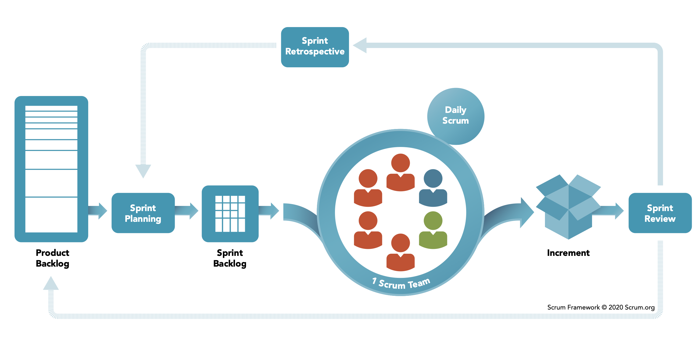
Scrum is the most common approach to organizing agile projects
Notes:
So, how do we go from this product backlog to some delivered software? Scrum is the most common approach to organizing agile projects. There are a few key vocabulary terms that you need to understand in order to talk about scrum, which hopefully won’t be too hard to understand. We’ve already seen one of the artifacts that are used in the scrum process: the product backlog.
Using this product backlog as our starting point, scrum organizes our development activities into sprints, which are time-boxed (fixed duration). Most commonly, sprints are 2 weeks, but it’s also not unusual to see a 30-day sprint. In scrum, we focus most of our planning activities on each of these sprints
The first phase of a sprint is planning: a meeting with the whole team. For a 2-week sprint this meeting is usually capped at 4 hours, and for a 30-day sprint, capped at 8 hours. In the first half of the meeting, the team decides on what can be done in the sprint, setting goals. Then the team decides on how to do that work, creating detailed tasks that will take one day or less.
During the sprint, there are short, “Daily Scrum” meetings – timeboxed to 15 minutes.
At the end, there is a sprint review of what was done, including key stakeholders and users, and a retrospective of what went well or could be improved.
Do not plan the next sprint until the last one is complete.
Implementing an effective scrum process is, however, much harder than reading this slide is – it helps to have a deep understanding of the agile principles to get into the right mindset. In particular, it’s important to reflect on the way that your team can inspect its performance and adapt to change. We’ll discuss each of these key steps, and continue to use the PlowTracker app as a running example.

Slide 19
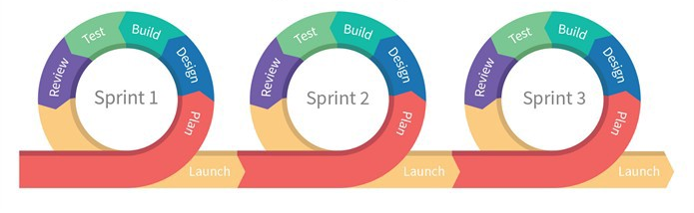
Agile Processes are Iterative
Agile Process Model
Iterative Waterfall Model
Initial Concept
Requirements
and Iteration
Planning
Next Iteration
Design and
Implement
Acceptance
Testing
and Delivery
Operations
Key Idea: Small Continuous Releases
Notes:
Let’s start with a process graphic.
The “process graphic” for agile looks very similar to the iterative waterfall model. Both contain the same phases, pretty much. Both contain a loop. What is different?
Agile has 3d rendering, colors, and round edges. (haha)
At its core, agile processes feature the same kinds of activities as the “traditional” processes before it. However, simply saying that you have multiple iterations of your project doesn’t really do anything to reduce the cost of changing requirements or late-detected defects.
The key idea in agile is being able to continuously evaluate the correctness and quality of software.

Slide 20
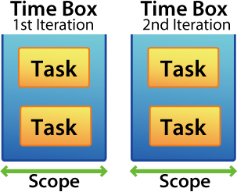
Agile Processes Reduce Risk by Time Boxing
Each “iteration” is called a “sprint”
Each sprint has a fixed duration
Scope of features in a sprint is determined by the team
Key insight: planning might be a guess at first, but gets better with time
More on agile planning & estimation in the next module
Notes:
Agile processes reduce risk by setting a time box: each iteration (called a “sprint”) has a fixed duration, typically 2-4 weeks (never more than that).
We say “time box” in contrast to “feature box” - a sprint isn’t defined by what functionality the team wants to deliver: it’s a fixed duration. The date can not change. Only the functionality (scope) can change.
By setting the duration of each sprint to a fixed amount of time, it forces a realistic schedule: it will become apparent quite quickly (after just several sprints) that a schedule is not attainable. How do we know it’s not attainable? Because at the end of the sprint, we find that we can’t finish everything.
We will discuss agile planning in detail in the next lesson. However, we’ll share now that the key insight that makes it work is that time estimation gets better with experience, and agile embraces that growth in experience.

Slide 21
Test Driven Development (TDD) is an Agile Practice
User story & conditions of satisfaction
1. Start here
2. Write a test
Failing Test
5. Strengthen Test
3. Write code
Passing Test
Passing Test, better design
4. Refactor design
Notes:
When Kent Beck was originally working on Agile, he called it "Test first programming" before writing the XP book. But halfway through the book he realized that programming was missing out on much more of what was going on when creating software, and while first is true, it doesn't connect the effect of the testing on the programming - it's not just testing FIRST and then programming, it's using tests to drive your programming. He is one of the biggest promoters of TDD.
Here is a more traditional picture of TDD.

Slide 22
Code Refactoring is a gradual and continuous process that reduces technical debt
Whenever you get a chance (while working on other features), if you see a code smell, fix it (i.e., take small steps)
Use IDE to your advantage
Rely on automated tests
Separate refactoring from features
For extensive refactoring: rely on code reviews where author explains the code/design to the team
Notes:
TDD is important in agile, because being able to continuously evaluate the correctness and quality of software is important.
As part of that mantra, you always want to keep an eye on the quality of your code and amount of technical debt.
As a team, you try to fix the code smell when you can and as you see it.
Don’t forget to mention Martin Fowler’s book on refactoring

Slide 23
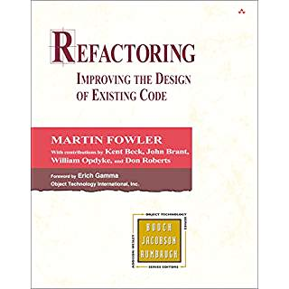
The Book
A catalogue of refactorings, similar to the design patterns in the GoF book
  Names each transformation
  Helpful for team communication
  Names “bad smells” (triggers for refactorings)
  Discusses when and how to apply refactorings and provides insight into tradeoffs
Notes:
If you are interested, you can find a lot more in the book:
UML diagrams to illustrate the situation before and after
examples of code before and after each refactoring

Slide 24
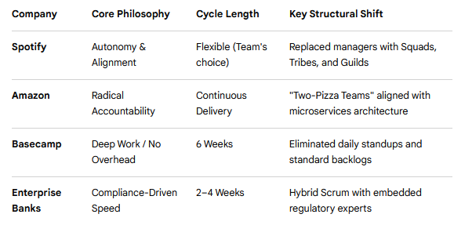
Be “agile” when designing your processes
As an organization, you tweak your process as needed (from team sizes, to sprint duration, backlogs to change requests, stand up meetings to code review, and so on)
Notes:
Each organization often tweaks different aspects of the “agile process” to suit their project or needs:
Basecamp rejected 2-week sprints and went to 6-week cycle called “Shape-up”
Spotify abandoned standard scrum management and replaced it with matrix structure to balance team autonomy with organizational structure. They allowed teams to use their own workflow like scrum or kanban or whatever
Amazon uses 2-pizza teams
Google uses sprints at lower level (teams have autonomy) but at higher levels they use OKRs (Objectives and Key Results)
Traditional Enterprise companies like Barclays, ING, Banks use Hybridized Agile which integrated regularity or security processes within sprint cycles.
Discussion Q: What variants have you seen in your internship/co-op?

Slide 25
Agility and You
In your project, you can display agility in some of the following ways:
  Renegotiate specs
  Reorder priorities
  Alter implementation strategy
  Improve team communication patterns
If you are agile, you can adjust these things to deliver your product on time and get a good grade ☺
Notes:
<read slide>

Slide 26
Learning Goals for this Lesson
At the end of this lesson, you should be able to
  Know the basic characteristics of the waterfall software process model
  Be able to explain when the waterfall model is appropriate and when it is not
  Understand how the waterfall and agile models manage risk
  Be able to explain how agile process instill quality, including through test driven development

